Slide 1
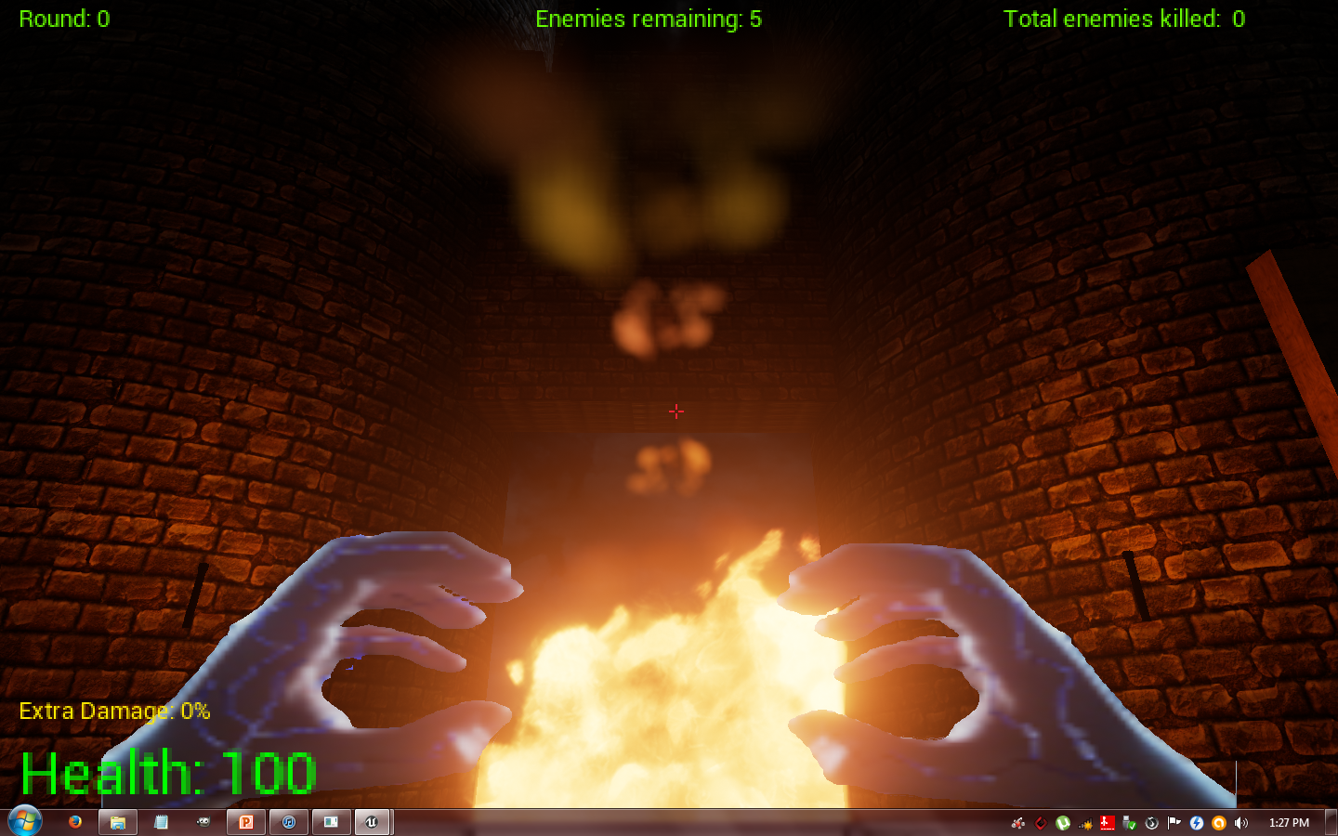
Elven Resurrection
A Computer Game Concept Design Project
By
Liam Magee
Jonathon Hart
Jorj Markou

Slide 2
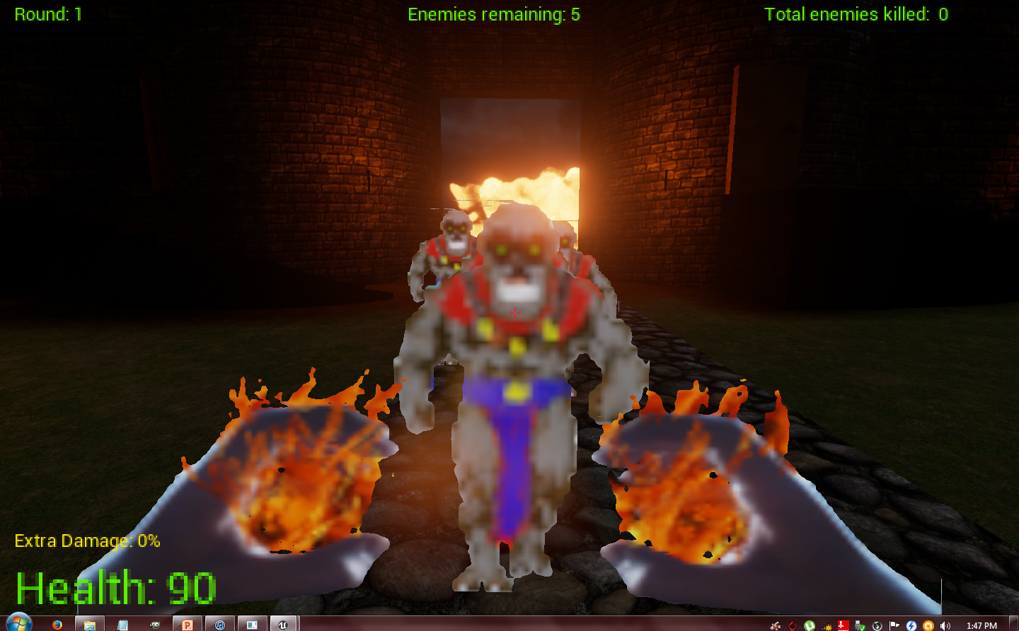
Story
You are an Elven Viking having awoken after the wrecking of your ship to find yourself on a hellish island overrun with demons possessing the tortured souls of a lost Aztec tribe.
In order to Survive you must resurrect the Holy trees which will restore purity to the land and the souls now possessed.

Slide 3
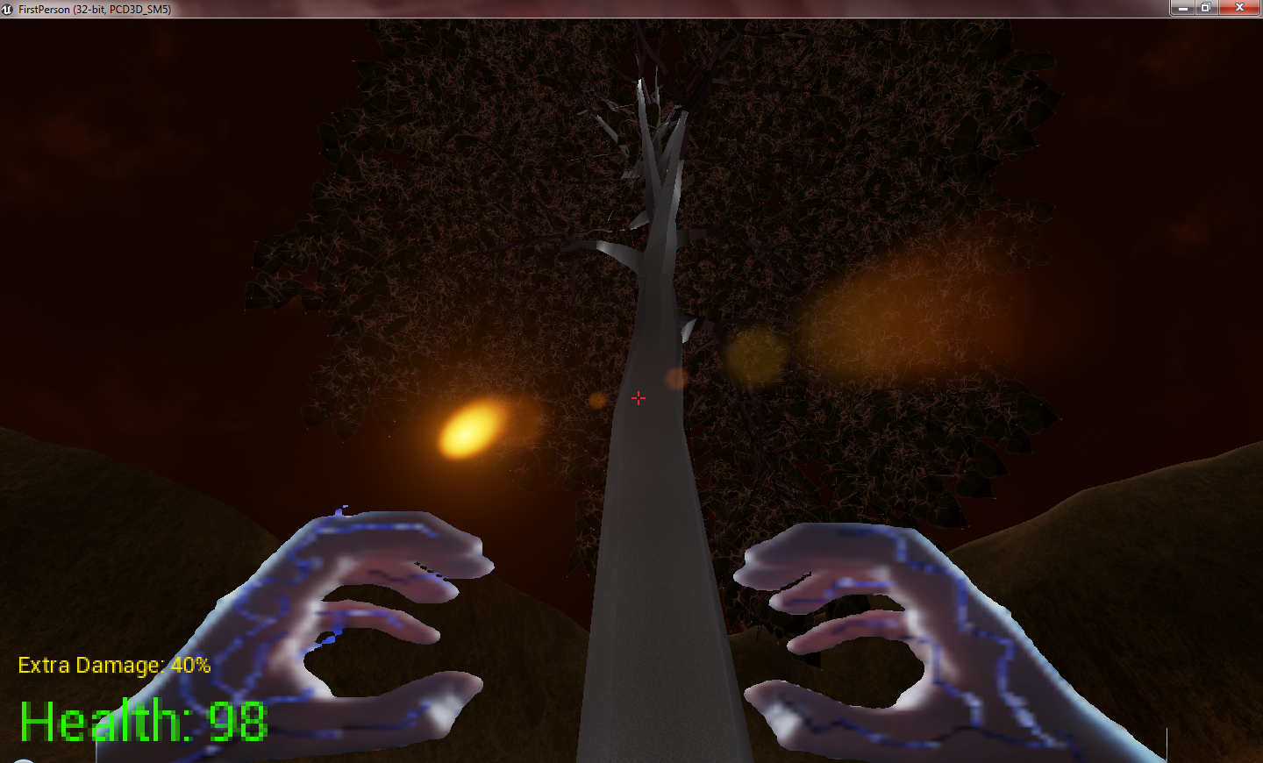
Modes
Campaign Mode
Desperately fight your way through a legion of the possessed to restore the holy trees and restore the land!
Arena Mode
Take a last stand as an endless hoard of the possessed relentlessly bombard you with cursed magic!

Slide 4
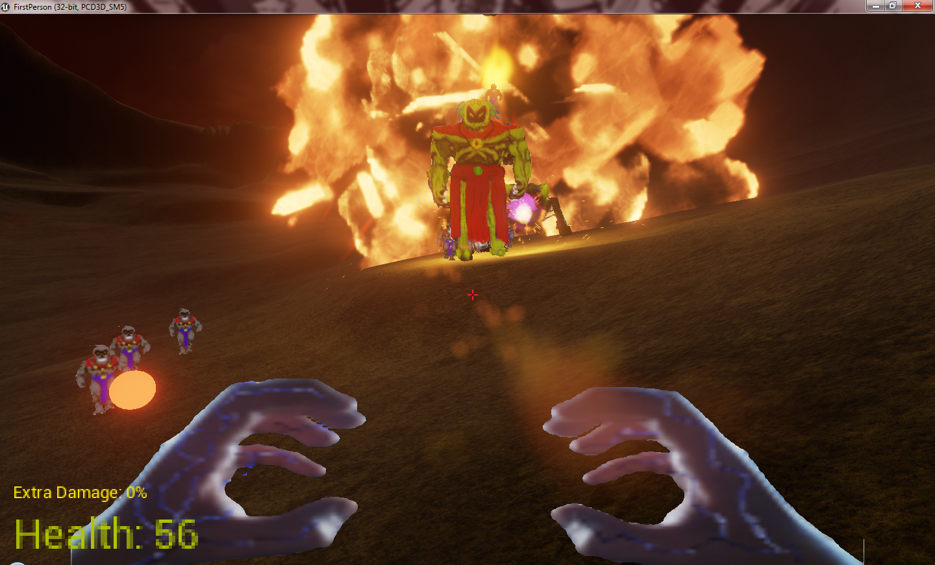
Bringing it Back!
Classic style 2D sprites wreak havoc in a high detail
3D world!
Modern take on a classic genre!

